Slide 1





Next Gen Employability Program
NEXT GEN EMPLOYABILITY PROGRAM
Creating a future-ready workforce
Team Members
College Name
Student Name :KANIMOZHI.G
Student ID :au511321104040
KINGSTON ENGINEERING COLLEGE

Slide 2

Next Gen Employability Program
CAPSTONE PROJECT SHOWCASE
Project Title
Building Bus Reservation System using Python and Django
Abstract | Problem Statement | Project Overview | Proposed Solution | Technology Used | Modelling & Results | Conclusion

Slide 3
Next Gen Employability Program
ABSTRACT:
The Bus Reservation System is a comprehensive software solution
designed to streamline the process of booking and managing bus tickets for passengers and operators. In an increasingly digitized world, this system provides an efficient and user-friendly platform for passengers to book their bus tickets online, as well as for bus operators to manage their fleet and schedules seamlessly.
The system offers a range of features tailored to meet the needs of both passengers and operators. For passengers, it provides an intuitive interface where they can search for available buses, view schedules, select seats, make payments securely, and receive e-tickets instantly. Additionally, passengers can manage their bookings, make cancellations, and view their booking history conveniently through the system.The Bus Reservation System aims to enhance the overall travel experience for passengers while improving efficiency and profitability for bus operators.

Slide 4
Next Gen Employability Program
PROBLEM STATEMENT:
Issue:
The current bus ticket booking process is cumbersome and inefficient, leading to dissatisfaction among passengers and operational challenges for bus operators.
Challenges:
Inconvenient booking process: Long queues and reliance on third-party agents.
Limited information accessibility: Lack of real-time information on schedules, routes, and seat availability.
Booking management complexity: Difficulty in managing bookings, changes, and cancellations.
Operational inefficiencies: Manual processes leading to resource wastage and revenue loss for bus operators.

Slide 5
Next Gen Employability Program
The project aims to develop a Bus Reservation System using Python and Django, a popular web framework, to modernize and streamline the bus ticket booking process for passengers while providing efficient management tools for bus operators. The system will consist of two main components: a user-facing interface for passengers to search for buses, book tickets, and track their journeys, and a backend dashboard for bus operators to manage routes, schedules, reservations, and analyze performance metrics.
PROJECT OVERVIEW:

Slide 6
Next Gen Employability Program
KEY FEATURES:
Key Features:
User Registration and Authentication:
Passengers and bus operators can register accounts and log in securely to access the system.
User authentication mechanisms ensure data security and privacy.
Route and Schedule Management:
Bus operators can add, edit, and delete routes, along with their schedules, timings, and fares.
Real-time updates to routes and schedules ensure accurate information for passengers.
Seat Selection and Booking:
Passengers can view available seats on buses and select their preferred seats during the booking process.
Secure online payment integration allows passengers to confirm their bookings.

Slide 7
Next Gen Employability Program
PROPOSED SOLUTION:
.
Reservation System:Customers can easily search, select, and book bus tickets online or through a mobile app.
Route Management:Bus operators can manage their routes, schedules, and fleet information through a comprehensive admin dashboard.
Data Analytics:The system will provide valuable insights and analytics to help bus companies make informed decisions.
Source :

Slide 8


Next Gen Employability Program
TECHNOLOGY USED:
Front-end
Back-end

Slide 9
Next Gen Employability Program
MODELING AND RESULTING:
User Management:Secure user registration, login, and profile management features.
Bus Schedule:Comprehensive database of bus routes, schedules, and availability.
Booking and Payments:Seamless ticket booking process with various payment options and confirmations.
Analytics and Reporting:Detailed reports on booking trends, revenue, and operational insights.. Performance evaluations ascertain the system's responsiveness, scalability, and reliability under various loads, optimizing performance for peak usage. Upon deployment, evaluation metrics such as user satisfaction, booking efficiency, and revenue generation are monitored closely.
Source :

Slide 10
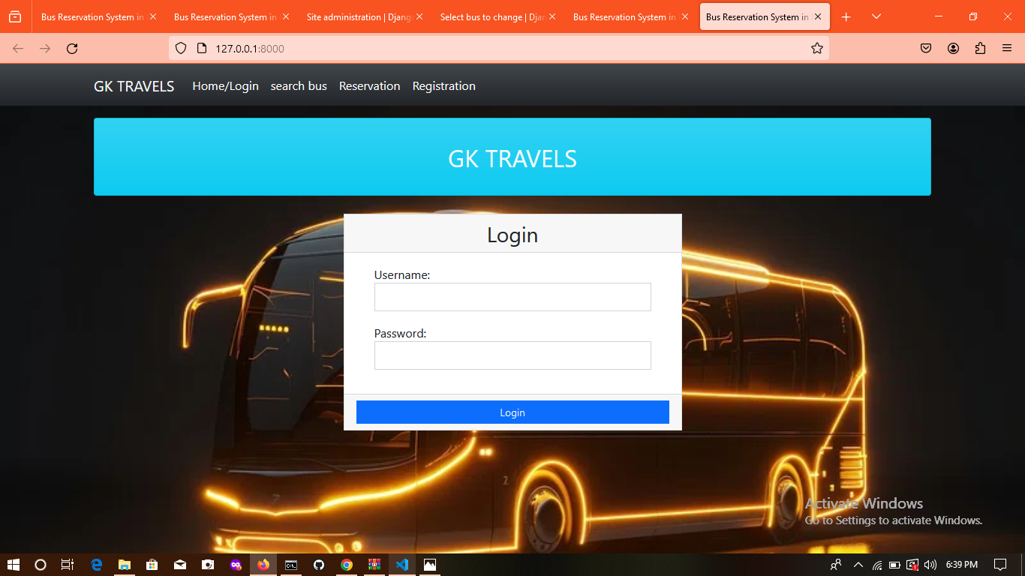
Next Gen Employability Program
HOMEPAGE:

Slide 11
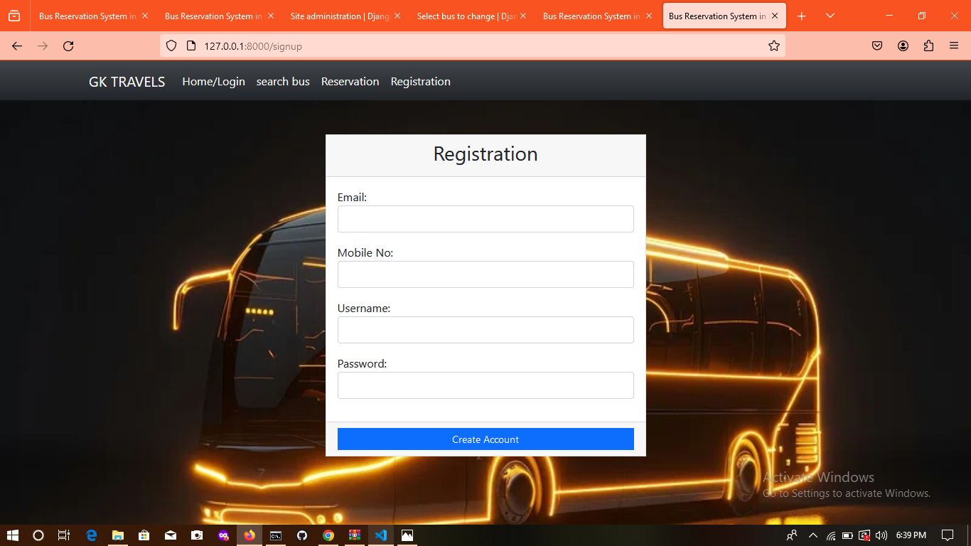
Next Gen Employability Program
ABOUT US PAGE:

Slide 12
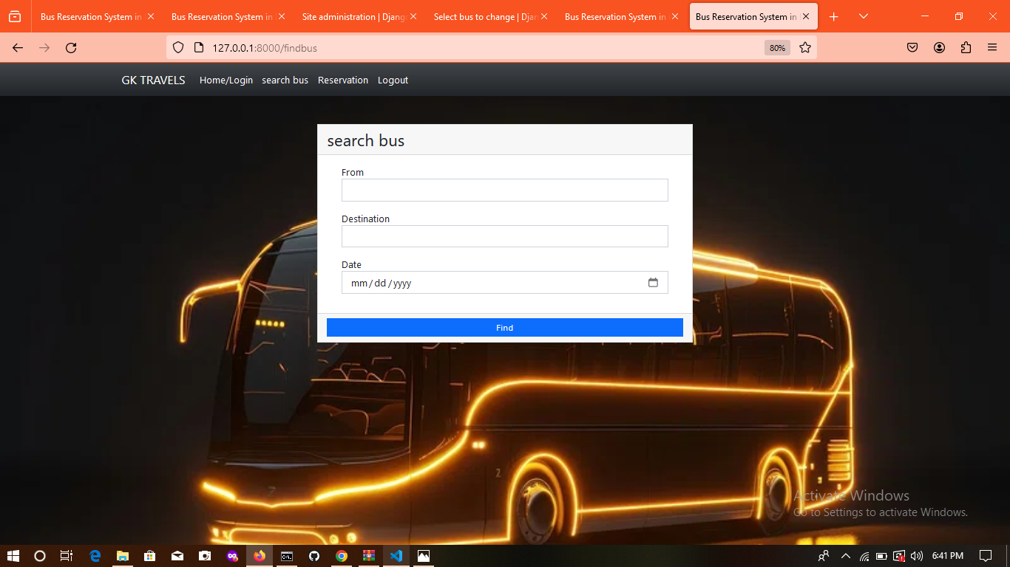
Next Gen Employability Program
SERVICE PAGE:

Slide 13
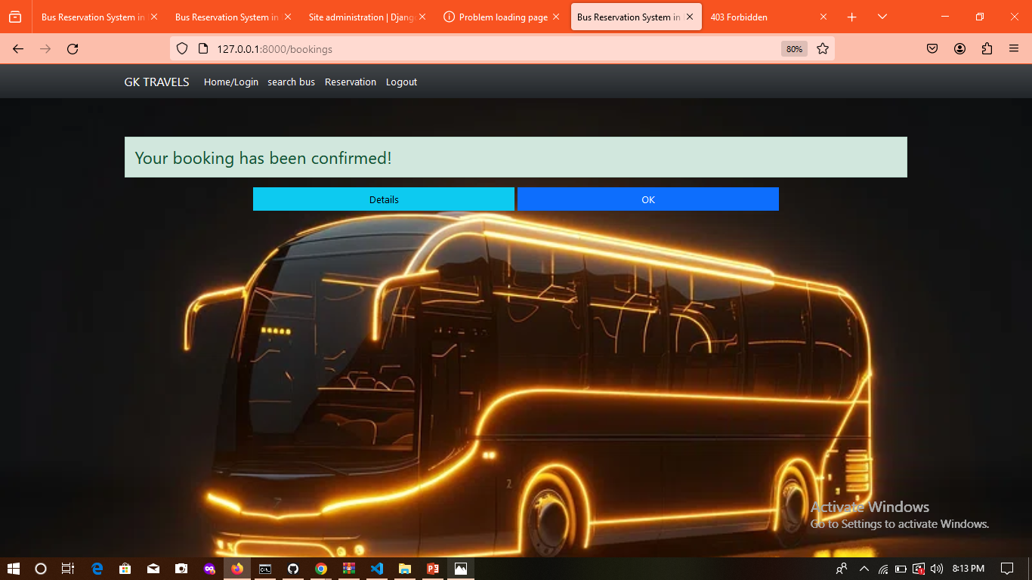
Next Gen Employability Program
DEPARTMENTS PAGE:

Slide 14
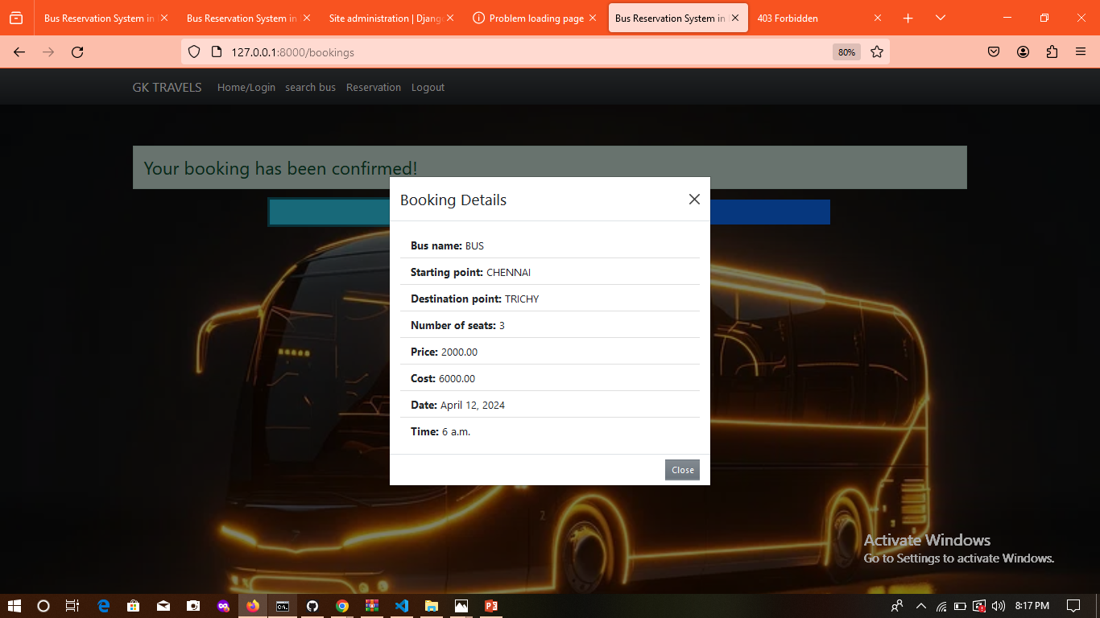
Next Gen Employability Program
BOOKING DETAILS:

Slide 15
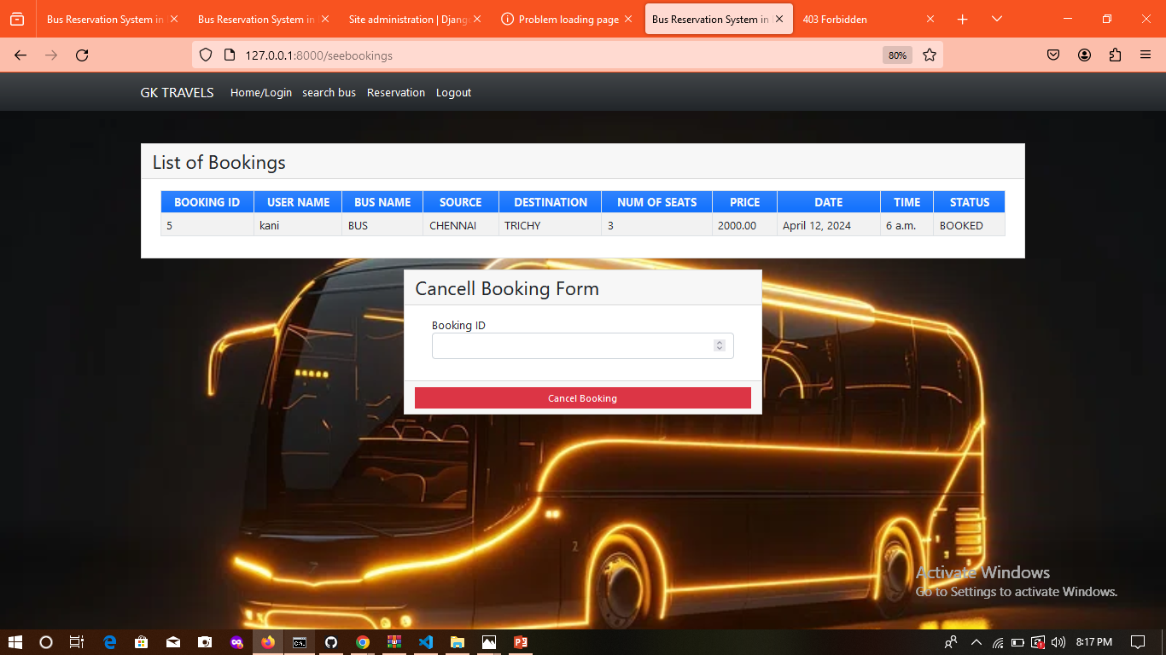
Next Gen Employability Program
BLOG PAGE:

Slide 16
Next Gen Employability Program
Future Enhancements:
integration with Travel Partners:Expand the system to integrate with other travel service providers such as hotels, airlines, and tour operators. This would enable users to book complete travel packages, including accommodation and flights, in addition to bus tickets.
Multi-language Support:Implement multi-language support to cater to a wider audience, especially in regions where multiple languages are spoken. This enhancement would improve accessibility and user experience for non-native speakers.
Dynamic Pricing and Discounts:Introduce dynamic pricing algorithms that adjust ticket prices based on factors such as demand, time of booking, and seat availability. Additionally, offer personalized discounts and promotions to loyal customers or during off-peak seasons.
Mobile App Development:Develop a mobile application for iOS and Android platforms to provide users with a seamless booking experience on their smartphones and tablets. The app could include features such as push notifications, GPS-based bus tracking, and offline ticket access.

Slide 17
Next Gen Employability Program
Feedback and Rating System:Implement a feedback and rating system where passengers can share their experiences and rate various aspects of their journey, including bus cleanliness, punctuality, and staff behavior. This would help improve service quality and build trust among users.
Social Media Integration:Enhance social media integration by allowing users to log in using their social media accounts and share their bookings or travel experiences with friends and followers. Integration with social media platforms can also be used for targeted marketing campaigns.
Real-time Analytics Dashboard:Develop a comprehensive analytics dashboard for bus operators to track key performance indicators in real-time, such as booking trends, revenue generation, route profitability, and customer demographics. This would enable operators to make data-driven decisions and optimize their services.
Accessibility Features:Improve accessibility features such as screen reader compatibility, keyboard navigation, and high contrast mode to make the system more inclusive for users with disabilities.

Slide 18
Next Gen Employability Program
CONCLUSION:
The development of the bus reservation system has been successfully completed, providing a user-friendly platform for booking bus tickets efficiently. Through this project, we have achieved the goals of streamlining the ticketing process, enhancing customer satisfaction, and improving overall operational efficiency for bus companies. The system's features, including real-time availability updates, secure payment processing, and user-friendly interface, have been thoroughly tested and implemented to ensure a seamless booking experience. Moving forward, ongoing maintenance and updates will be essential to keep the system robust and adaptable to future needs. Overall, the bus reservation system project has been a significant step towards modernizing bus ticketing services, benefiting both passengers and service providers alike

Slide 19
Next Gen Employability Program
Thank You!

